Slide 1
Offline Quickstart
Convert a site to work offline

Slide 2

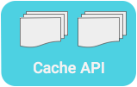

Caching files for offline
1. Store 2. Retrieve
Notes:
Increasingly, the majority of growth in internet traffic comes from mobile-first and (in some cases), mobile-only connections. This is often in regions where internet connectivity is sparse, expensive or just unreliable.
Building for billions on the web
Remind the class of the reasons for working off-line or in unreliable networks:
Users can still have SOMETHING, under any conditions.
Performance - getting resources from the cache is much faster than waiting for the network!
Enables native features - add push notifications, geofencing, background data syncing
How could we make an existing site work off-line?
You might use the browser cache, but it's not quite good enough -- it will fail if the browser is off-line
You might use the older AppCache (not shown) and a list of URLs to cache. It will work, but often has problems.
The recommended way: Use Service Worker.
1) You write a small script that fetches and stores the files via the Cache API.
2) The same script intercepts fetch events (inside the service worker) and retrieves the file from the cache.
3) If you ever need to, you can update files via the Cache API
Note: The Cache API lets you set up multiple caches, shown here as collections of files.

Slide 3
Register a service worker
if ('serviceWorker' in navigator) { navigator.serviceWorker.register('service-worker.js') .then(function(registration) { console.log('Registered:', registration); }).catch(function(error) { console.log('Registration failed: ', error); }); }
Notes:
Always have to start by registering a service worker

Slide 4

Caching files for offline
1. Store 2. Retrieve
Notes:
The first step is to store (cache) files

Slide 5
Cache static assets
var CACHE_NAME = 'static-cache'; var urlsToCache = [ '.', 'index.html', 'styles/main.css' ];
service-worker.js
Notes:
A common strategy is to cache your site’s static assets when the service worker installs. Then once a user has visited your site for the first time, the site’s static content can be retrieved from the cache on all future visits.
Here we prepare a list of static assets to cache.
Note:
that “.” is also cached. This represents the current directory, for example, app/. If the browser is navigated to app/, it will show app/index.html. However, app/ and app/index.html are separate URL’s, so a 404 will still occur if the browser is navigated to app/ and only app/index.html is available. They should both be cached to be safe.

Slide 6
Cache static assets
self.addEventListener('install', function(event) { event.waitUntil( caches.open(CACHE_NAME) .then(function(cache) { return cache.addAll(urlsToCache); }) ); });
service-worker.js
Notes:
The service worker passes an "install" event to its script after initialization. Here we are using the Cache API (note: promise-based) to create a cache and populate it with a set of files.

Slide 7
Caching files for offline
1. Store 2. Retrieve
Notes:
Once you've store files, they can be retrieved

Slide 8
Intercept the fetch event
self.addEventListener('fetch', function(event) { event.respondWith( caches.match(event.request) .then(function(response) { return response || fetch(event.request); }) ); });
service-worker.js
Notes:
The service worker passes a "fetch" event to its script anytime a resource in it's scope is requested.
Here we check if the requested resource is stored via the Cache API (and return it if it is), otherwise we try the network.

Slide 9
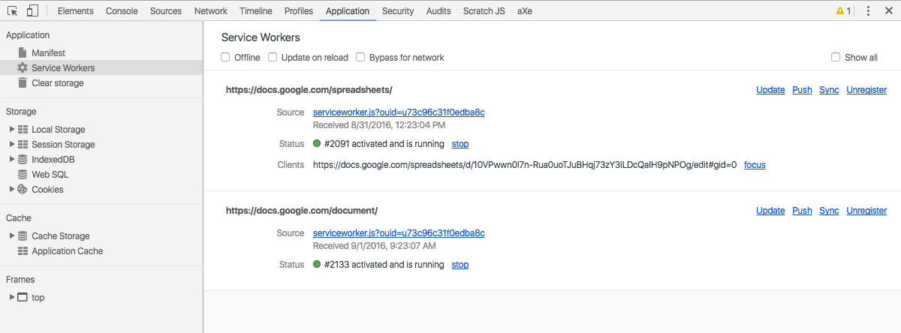
Examining the Service Worker
Notes:
You can use Dev Tools to check the status of your service worker, and for testing and debugging.
Open DevTools with F12 or Ctrl + Shift+ I on Windows Or Cmd + Opt + I on Mac
The command is also available under the View > Developer > Developer tools
When you click the application tab you will see the current page’s service worker along with some developer helpers to make working with the service worker easier.
There are three checkboxes:
Offline: forces the browser offline, simulating no network connectivity
Update on Reload: reloads the service worker every time the browser reloads, picking up all changes during development
Bypass for network: Ignores the service worker and fetches all resources from the network

Slide 10
Lab overview
Lab overview
Use a service worker to make an app run offline
Cache the app's resources
Use cached resources instead of the network

Slide 11
Resources
Resources
Offline Cookbook
Building for billions
Is ServiceWorker Ready?
Mozilla Developers Network
Intro to service workers
Fetch Event

Slide 12
Extra credit

Slide 13
Install to Homescreen
{ "name": "Demo Blog Application", "short_name": "Demo Blog Application", "start_url": "index.html", "icons": [{ "src": "images/touch/icon-128x128.png", "sizes": "128x128", "type": "image/png" }], "background_color": "#3E4EB8", "display": "standalone", "theme_color": "#2E3AA1" }
manifest.json
Notes:
While not directly related to offline technologies the manifest is important in providing an application like experience for users in Chrome for Android.
It allows applications to install on the user’s home screen. Using the manifest (a JSON) file we can indicate the name (short and long) for the application, what file will the application open when it loads, what icons to use, background and theme color along with the type of display for the application.

Slide 14
Recall - fetching from the cache first
self.addEventListener('fetch', function(event) { event.respondWith( caches.match(event.request) .then(function(response) { return response || fetch(event.request); }) ); });
service-worker.js
Notes:
This is how we were fetching resources earlier - check the cache first, and then go to then go to the network if the resource isn't in the cache.
Next we will look at caching resources that we get from the network.

Slide 15
What if we want to cache responses?
self.addEventListener('fetch', function(event) { event.respondWith( caches.match(event.request) .then(function(response) { return response || fetchAndCache(event.request); }) ); });
service-worker.js
Notes:
Just like the previous example, this will look for files in the cache first, and return them if available. If they are not in the cache, it will go to the network.
However this example will also cache resources that are fetched from the network.

Slide 16
Fetch & store missing files
function fetchAndCache(url) { return fetch(url).then(function(response) { return caches.open(CACHE_NAME).then(function(cache) { cache.put(url, response.clone()); return response; }); }); }
service-worker.js
Notes:
This function will fetch a resource, cache a clone of the resource, and return the original.
Note:
Fetch responses are streams, and can only be consumer once. This is why they must be cloned if used in multiple places.

